Slide 1
Lending Club underwriting criteria
Giulianna Perrotti
November 2016

Slide 2

The Question
Can I outsmart Lending Club underwriting criteria to maximize my personal investment returns?

Slide 3
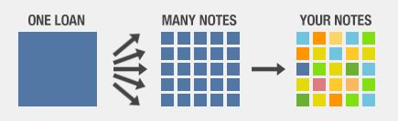
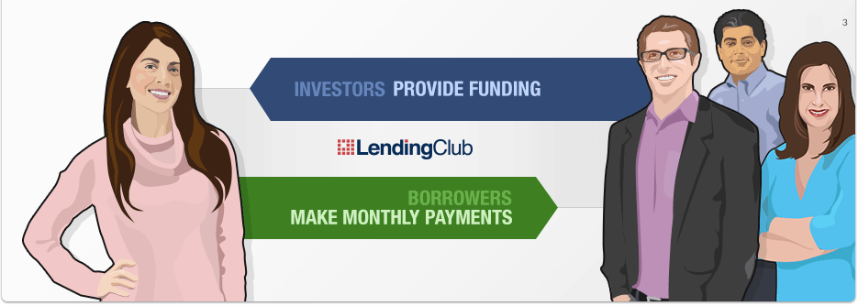
Crash Course: Lending Club

Slide 4

Crash Course: Lending Club
Peer to Peer Lending
More Risk = More Interest = More Returns
More Risk = More Default = Less Returns

Slide 5
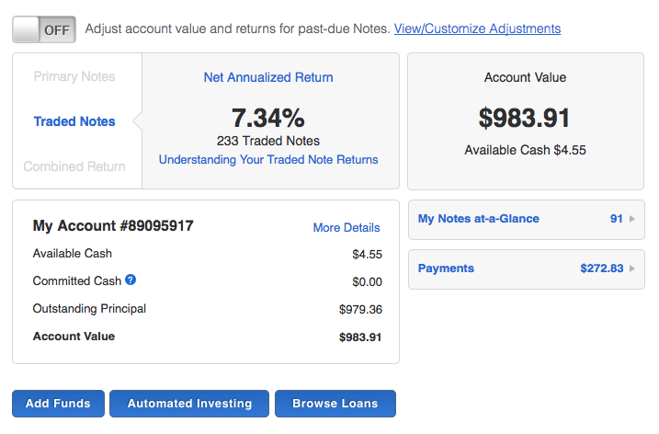

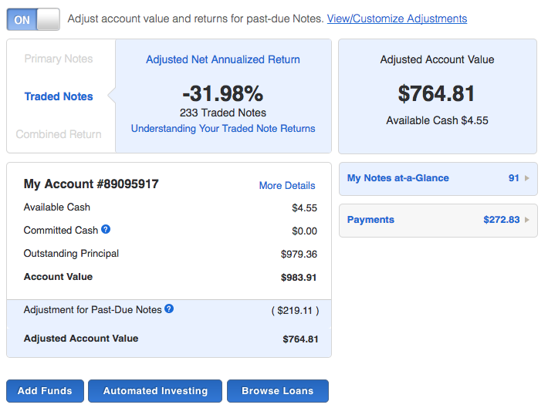
Impact of Defaults
The difference between ‘meh… bad but better than my bank’ and ‘OMG, I should have gone shopping’

Slide 6

The Data
Publicly available LC Data
1.2 MM observations
150+ columns
Contains:
Loan Information
‘Social’ Information
Tradelines Information
Public Records Information

Slide 7
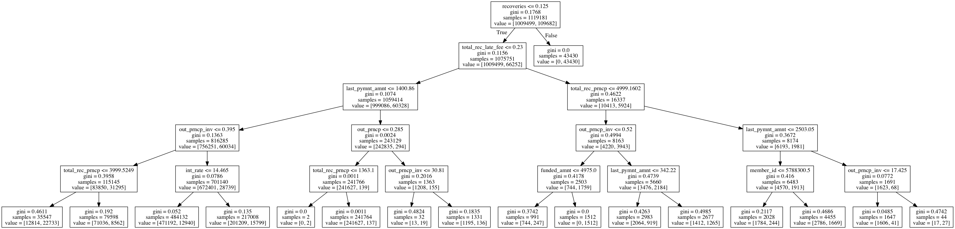
The Tree

Slide 8
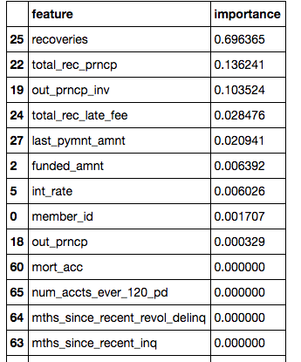
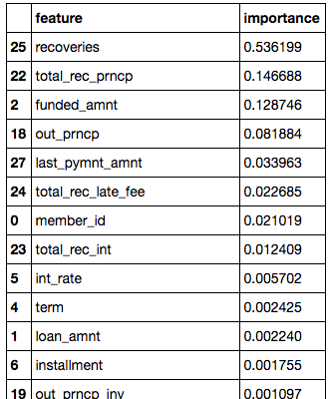
What I found so far
Don’t trust anything below this point!

